Slide 1
Programming Session 19
Test automation, debugging
Architecture /Singelton
Exercise in 3 layered architecture

Slide 2
Architecture
A systems architecture is the overall structure in the system and shows components their abilities and their connections
The system architecture describes the behaviour and interaction between components

Slide 3
Architecture and design classes
In order to realize the use cases in a layered architecture we will need three different types of classes
(User) Interface classes handling interaction between the actor and the interface
Controller classes which is the glue layer between interface and domain classes. The handlig of use cases happens in this layer.
Model classes which are derived from the domain model of the problem domain. Also called domain classes.

Slide 4
Design of a layered logical architecture
Goal: to create an understandable and flexible structure (it will also be easy to maintain).
HowTo: Create packages (components)
Use high cohesion and low coupling
Minimum package size: One class
Maximum package size: A system (e.g. all the classes in the model layer)

Slide 5
A Layered Basis Architecture
Presentation Layer
(User Inteface)
Application/Control Layer
(Business Logic)
Domain Layer
(Model)

Slide 6
Open and Closed Architectures
Closed Architecture
Only access to layer below
Open Architecture
Access to all layers below

Slide 7
3-layered open architecture
ui
controller
Read only
model

Slide 8
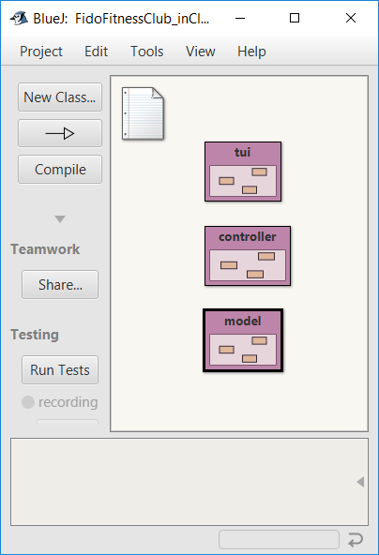
Implementation of a 3 layered architecture
Layers are implemented as packages
Naming conventions:
Package names start with lower-case letters
Package names do not contain uppercase letters

Slide 9

The need for singletons
Highlander: There can be only one!
We need the Singleton pattern in order to implement a Container :
Ensures only one instance of a class can exist
If we had several instances of the container class, we wouldn’t know where to insert a newly created object.
“In 2hich pockeet did I put it now…”

Slide 10
How to: Singleton 101
Private constructor: ensures the object is created inside the class
Static instance variabel of the class
Implement a static getInstance() method.
If an object already exists it will return that else it will create an object

Slide 11
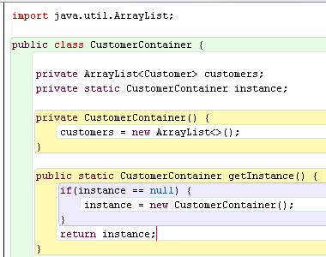
Singleton
Static instance
variable
Private constructor
Static metod to get the object

Slide 12
Exercise
Open the FidoFitnessClub solution
Consider CRUD use cases for a Member (disregard dogs for now)
Document as you see fit. A use case diagram may be the solution
In the following, we use open three-layered architecture
Draw interaction diagrams for Create and Read
You decide if you use sequence diagrams or communication diagrams
Remember to include a container class!
Design the classes
Make a design class diagram for the control and model layers
Implement your design bottom-up or top-down
Bottom-up: Add the container, add the controller that uses the container
Top-down: Add the controller, use the Mañana principle to implement the Container
Remember to make the MemberContainer a singleton
Optional: Create a TUI that uses the controller
Challenge: Create a re-usable TUI library and use it

Slide 14
Refactoring
Class
Code added
Longer & more methods
Refactoring
Low coupling
High cohesion

Slide 15
Refactoring and test
When refactoring code, separate the refactoring from making other changes.
1. Refactor only
Functionality stays the same
2. Test
Should behave the same
Nothing broken
3. Now, you can add new functionality

Slide 16
When refactoring remember The Mañana Principle Specific Rules
When, during implementation of a method,
you wish you had a certain support method or object,
write your code as if you had it.
Implement it later.
Specific Rules
Special Case
Nested Loop
Code Duplication
Hard Problem
Heavy Functionality
Special Case Rule
If you write code to treat a special case in your algorithm, treat the special case in a separate (private) method.

Slide 17
Code snippet of the day
public void test() {
int sum = 1;
for (int i = 0; i <= 4; i++);
{
sum = 1+ ++sum;
}
System.out.println("The result is: " + sum);
System.out.println("Double up: " + sum+sum);
}
What is the output?
public void test() {
int sum = 1;
for (int i = 0; i <= 4; i++);
{
sum = sum + 1;
}
System.out.println("The result is: " + sum);
System.out.println("Double up: " + sum+sum);
}

Slide 18
We have to deal with errors
Early errors are usually syntax errors.
The compiler will spot these.
Later errors are usually logic errors.
The compiler cannot help with these.
Also known as bugs.
Some logical errors have no immediately obvious manifestation.
Commercial software is rarely error free.

Slide 19
Prevention vs Detection (Developer vs Maintainer)
We can lessen the likelihood of errors.
Use software engineering techniques, like encapsulation.
We can improve the chances of detection.
Use software engineering practices, like modularization and documentation.
We can develop detection skills
Test
Debugging

Slide 20
Testing and debugging techniques
Unit testing (within BlueJ)
Test automation
Manual walkthroughs (Rubber Duck Debugging)
Print statements
Log files
Debuggers

Slide 21
The V-Model
Requirements
(Analysis)
Acceptance Test
Architecture
(Design)
Integration Test
Classes
(Design)
Testing Classes
Methods
(Design)
Testing Methods
Coding

Slide 22
Testing fundamentals
Understand what the unit should do – its contract.
You will be looking for violations.
Use positive tests and negative tests.
Test boundaries.
Zero, One, Full.
Search an empty collection.
Add to a full collection.

Slide 23
Test automation
Good testing is a creative process, but ...
... thorough testing is time consuming and repetitive.
Regression testing involves re-running tests.
Regression?
Breaking something as a consequence of a fix
Local (new bug)
Remote (our change breaks something else)
Unmasked (old bug with no effect causes problems now)
Using a test rig or test harness can relieve some of the burden.
Classes are written to perform the testing.
Creativity focused in creating these.

Slide 24
JUnit
JUnit is a Java test framework
Test cases are methods that contain tests
Test classes contain test methods
Assertions are used to assert expected method results
Fixtures are used to support multiple tests

Slide 25
Exercises
From the Session folder: Open the JUnit project, for instructions, read the README file in the project.
Add JUnit test cases to the three-layered FidoFitnessClub solution
Explore through the online-shop project (BlueJ 9.4)
Solve exercises 9.1 – 9.20

Slide 26
Prevention vs Detection (Developer vs Maintainer)
We can lessen the likelihood of errors.
Use software engineering techniques, like encapsulation.
We can improve the chances of detection.
Use software engineering practices, like modularization and documentation.
We can develop detection skills.

Slide 27
Debugging techniques
Manual walkthroughs
Print statements
Debuggers

Slide 28
Debugging
It is important to develop code-reading skills.
Debugging will often be performed on others’ code.
Techniques and tools exist to support the debugging process.

Slide 29
Manual walkthroughs
Relatively underused.
A low-tech approach.
More powerful than appreciated.
Get away from the computer!
‘Run’ a program by hand.
High-level (Step) or low-level (Step into) views.

Slide 30
Tabulating object state
An object’s behavior is usually determined by its state.
Incorrect behavior is often the result of incorrect state.
Tabulate the values of all fields.
Document state changes after each method call.

Slide 31
Verbal walkthroughs
Explain to someone else what the code is doing.
They might spot the error.
The process of explaining might help you to spot it for yourself.
Group-based processes exist for conducting formal walkthroughs or inspections.

Slide 32
Print statements
The most popular technique.
No special tools required.
All programming languages support them.
Only effective if the right methods are documented.
Output may be voluminous!
Turning off and on requires forethought.

Slide 33
Choosing a test strategy
Be aware of the available strategies.
Choose strategies appropriate to the point of development.
Automate whenever possible.
Reduces tedium.
Reduces human error.
Makes (re)testing more likely.

Slide 34
Debuggers
Debuggers are both language- and environment-specific.
BlueJ has an integrated debugger.
Support breakpoints.
Step and Step-into controlled execution.
Call sequence (stack).
Object state.
The bug may be far away from the clue

Slide 35
Debugging
Know what triggers the error
Breakpoint @ 1st LOC in method with error
Look at variable values
If error comes from method call:
Put breakpoint on methd
Start over
Step into the offending method
If not possible to step into: derive reason from variable values

Slide 36
Review
Errors are a fact of life in programs.
Good software engineering techniques can reduce their occurrence.
Testing and debugging skills are essential.
Make testing a habit.
Automate testing where possible.
Practice a range of debugging skills.

Slide 37
Modularization and interfaces
Applications often consist of different modules.
E.g. so that different teams can work on them.
The interface between modules must be clearly specified.
Supports independent concurrent development.
Increases the likelihood of successful integration.

Slide 38
Exercises
All exercises in section 9
Solve JUnit from the session folder
Explore through the calculator-engine-print project – focus on 9.22 – 9.36 (starting in Section “Commenting and style”).

